Slide 1
3 gene 4 edge networks

Slide 2
LSE – no constants

Slide 3
LSE – B constant

Slide 4
LSE – P constant

Slide 5
P and B constant

Slide 6
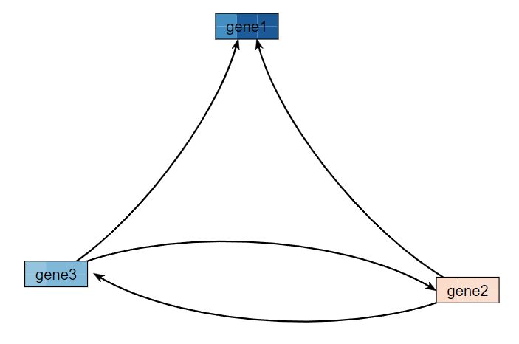
Trial 9

Slide 7
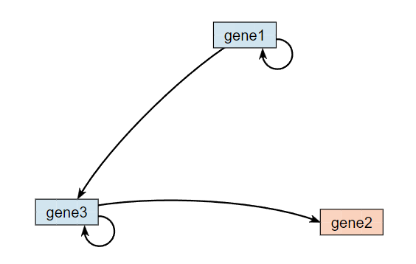
Trial 14

Slide 8
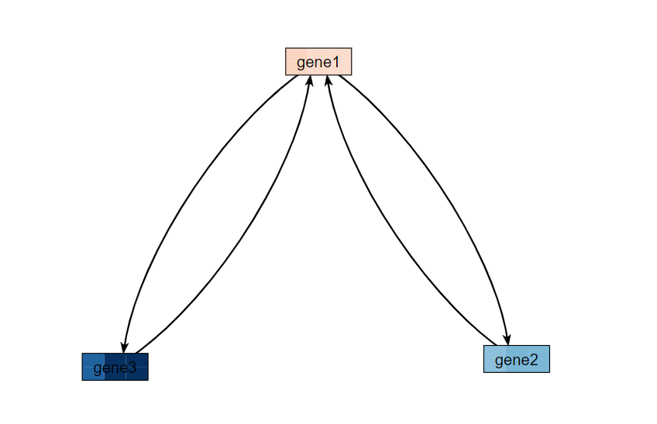
Trial 10

Slide 9
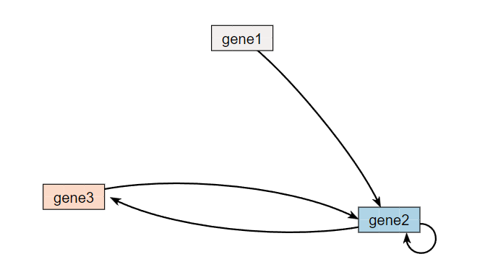
Trial 2

Slide 10
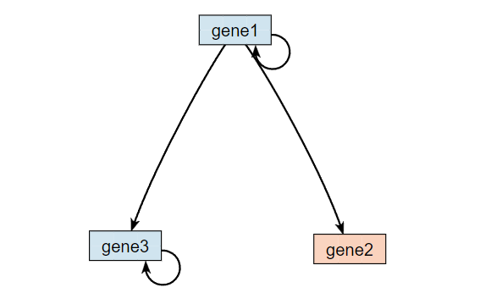
Trial 17

Slide 11
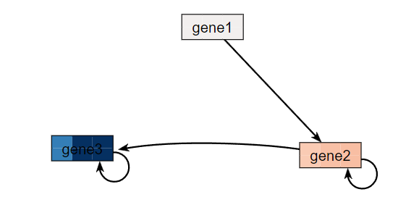
Trial 20

Slide 12
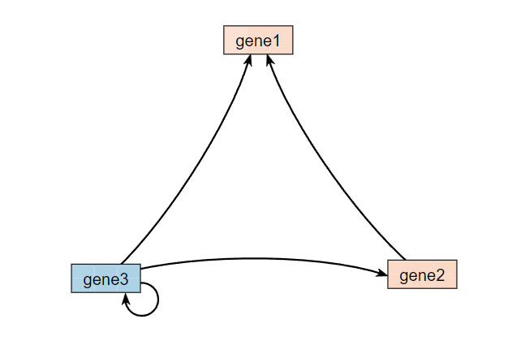
Trial 6

Slide 13
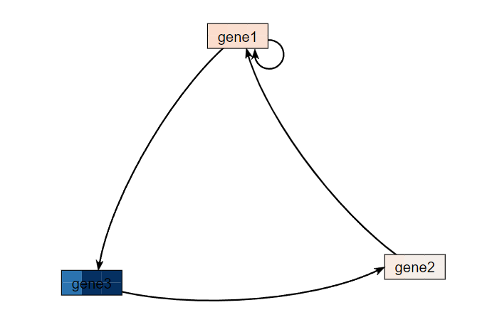
Trial 3

Slide 14
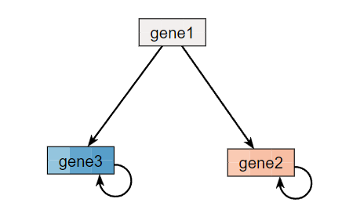
Trial 21

Slide 15
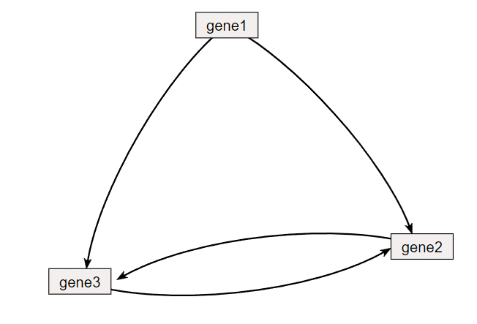
Trial 1

Slide 16
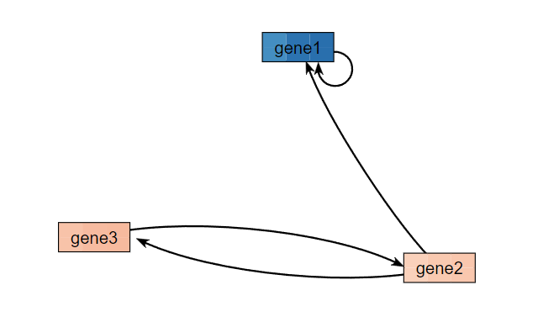
Trial 5

Slide 17
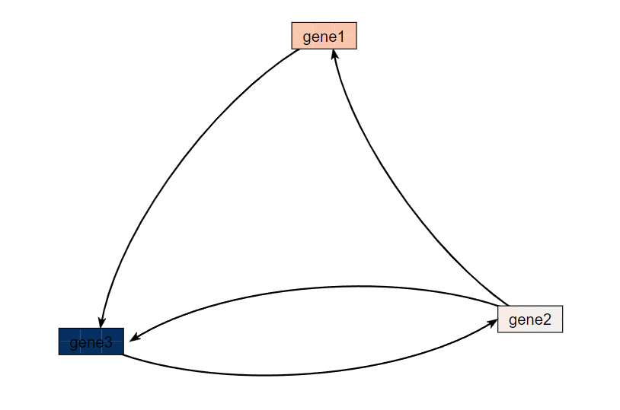
Trial 8

Slide 18
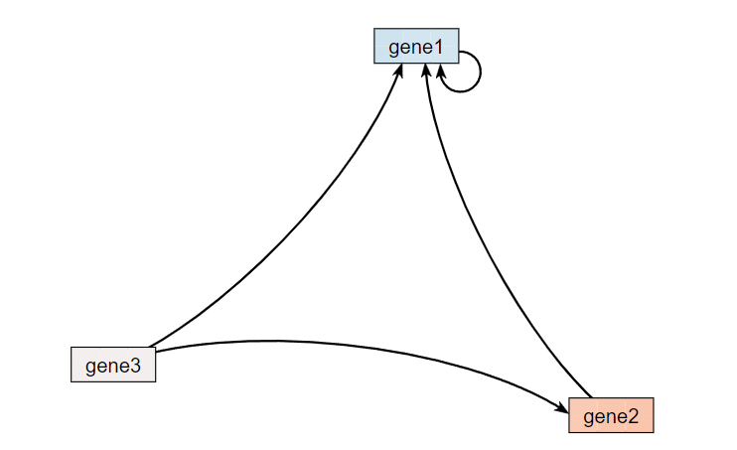
Trial 11

Slide 19
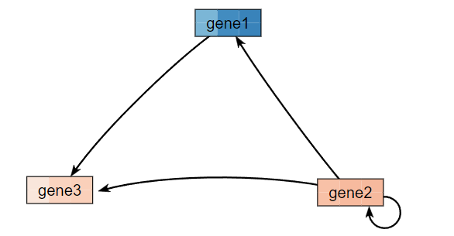
Trial 16

Slide 20
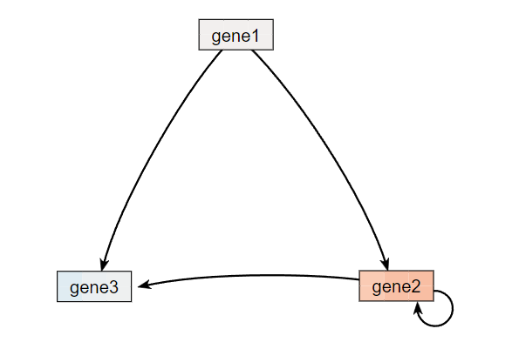
Trial 12

Slide 21
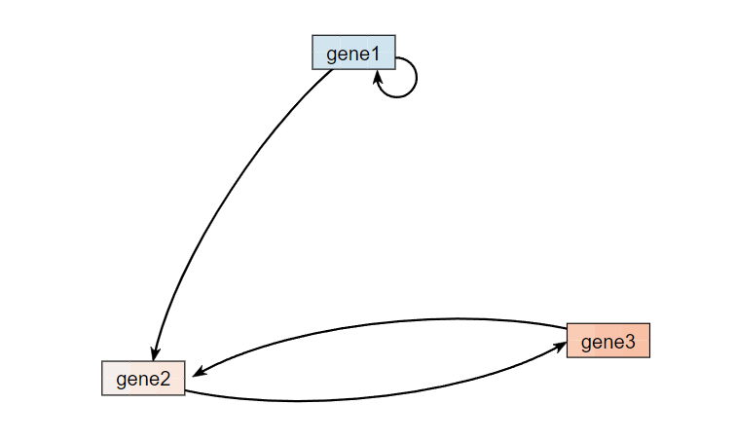
Trial 7

Slide 22
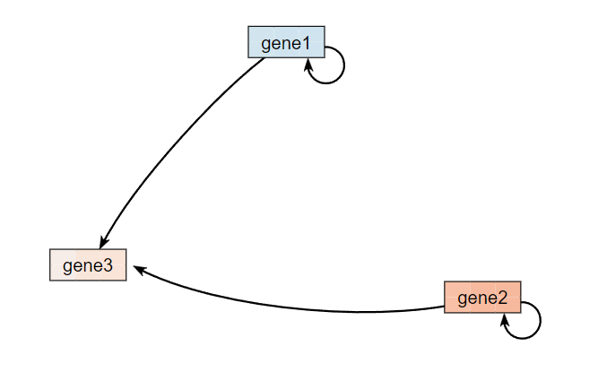
Trial 13

Slide 23
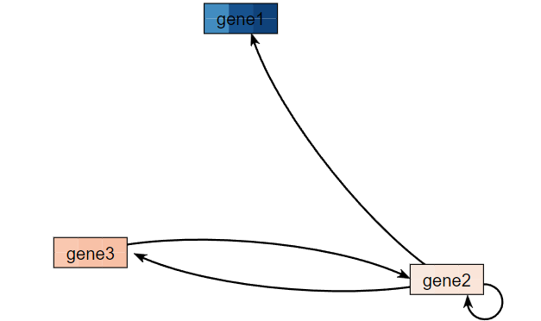
Trial 4

Slide 24
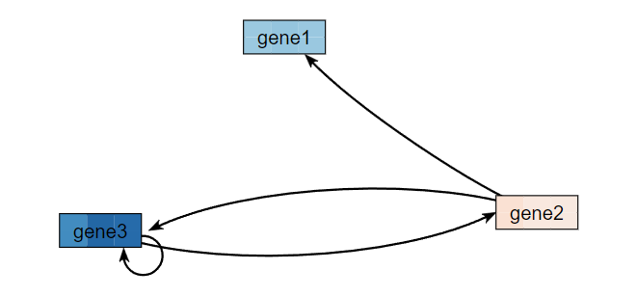
Trial 15

Slide 25
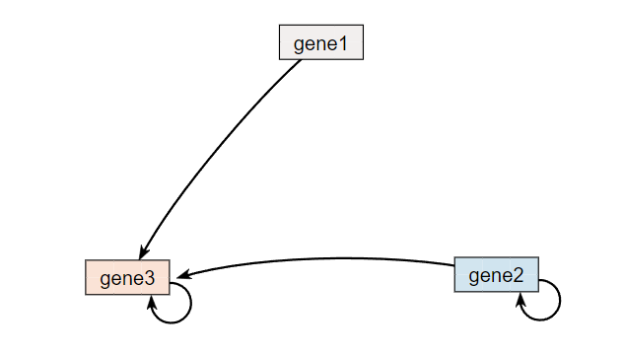
Trial 18

Slide 26
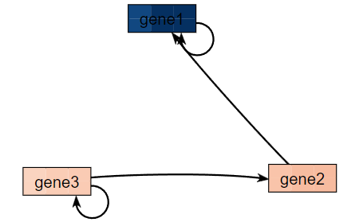
Trial 19

Slide 27
Grouping Possibilities

